Slide 1

Chapter 14
Media and Media Literacy

Slide 2
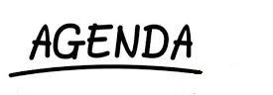
Nature of Media
Functions of Media
Effectiveness of Media
Influence of Media

Slide 3
Mass Media
Electronic or mechanical channels of delivering one-to-many communication
Film, television, radio, newspapers, magazines
RobinBeckham/Beepstock/Alamy Stock Photo

Slide 4
Social Media
Means of connecting and interacting actively
Smartphones, tweets, texts, Instagram, email, iPads, MP3s, websites, etc.
In an average day, how many text and IM messages do you send?

Slide 5
Digitalization
The primary difference between mass media and social media
Implications
Ease of manipulation
Convergence
Nearly instant speed

Slide 6
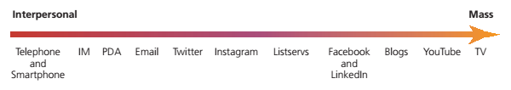
The Media Continuum
Cengage Learning

Slide 7
Uses and Gratification Theory
We choose mass communication to gratify ourselves
People are active agents who make deliberate choices among media

Slide 8
Agenda Setting
Selecting and calling to the public’s attention ideas, events, people, and perspectives
Media divert attention from some topics
Gatekeeper
A person or group that decides which messages pass through the gates of media to reach consumers
Producers, editors, Webmasters, advertisers, etc.

Slide 9
Cultivation Theory
Television promotes a worldview that is inaccurate but that viewers nonetheless assume reflects real life
The prevalence of violence in movies and television programs can make the world seem more violent than it is

Slide 10
Cultivation Theory (cont’d)
Cultivation
A cumulative process by which television shapes beliefs about social reality
Means by which cultivation occurs
Mainstreaming
Resonance

Slide 11
Ideological Influence
Mass media function as tools to represent the ideology of privileged groups as natural and good
Jg Photography/Alamy Stock Photo

Slide 12
Understanding Social Media
Blur production and consumption
Alter conceptions of space
Invite supersaturation
Encourage multitasking

Slide 13
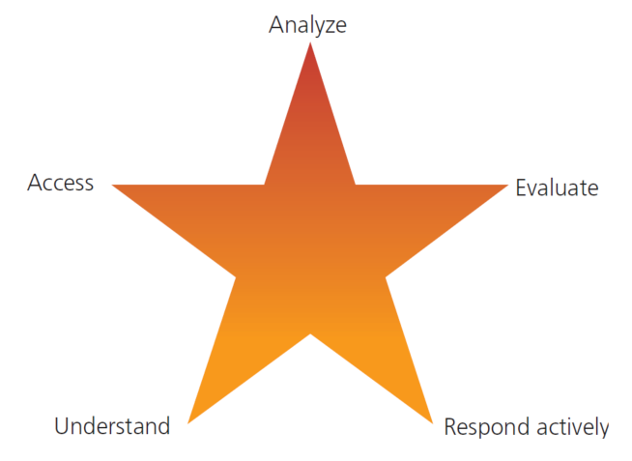
Media Literacy (slide 1 of 3)
Cengage Learning

Slide 14
Media Literacy (slide 2 of 3)
Understand the influence of media
Access to media
Democratic access
Digital divide between those with access and those without
Expose yourself to a range of media sources
Analyze Media
Ways that media construct the news
Select what gets covered
Choose the hook
Choose how to tell the story

Slide 15
Media Literacy (slide 3 of 3)
Critically evaluate media messages
Puffery
Respond actively
Use mass communication consciously
Participate in decision making about media

Slide 16
WebLinks
11.1: Susan Crawford
Susan Crawford is a legal scholar. Her columns and op-ed pieces give her opinions on a range of cyberspace-related legal issues

Slide 17
Websites
Citizens for Media Literacy
Media Literacy Online Project
University of Oregon – Eugene
FAIR: Fairness and Accuracy in Reporting
Society of Professional Journalists
Impact of Entertainment Violence
American Society of Newspaper Editors
Falling Through the Net: Defining the Digital Divide
U.S. Department of Commerce

Slide 18
Summary
Media
Social Media
Digital Literacy
Chapter 14
Effects of Media
Types of Media
Media Theories
Functions

